Slide 1
Slow DDoS in existing Smart Grid papers
Morgan

Slide 2
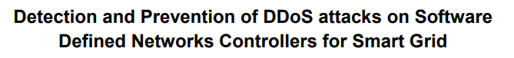
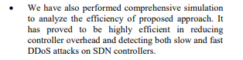
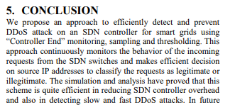
Very little mention of low-rate DDoS but does mention it as a contribution for detection of it.
Results do not indicate anything involving slow DDoS attacks vs regular
Paper mostly focused on blockchain detection using distributed SDN controllers

Slide 3

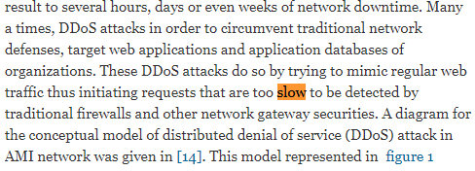
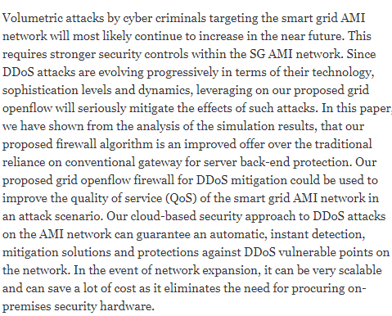
Paper talks about slow DDoS in overview briefly, but conclusion speaks about detecting volumetric attacks only.
This paper is more mainly about developing an Openflow FireWall.
No talk about what types of attacks or metrics their firewall is tested against.

Slide 4
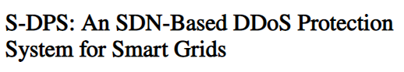
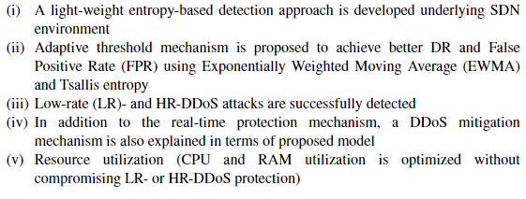
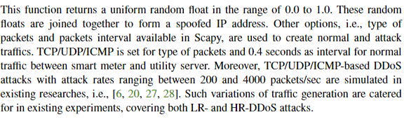
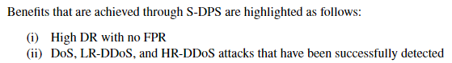
Paper specifically mentions the lack of other papers ability to handle low-rate DDoS and mentions it in contributions of the paper
Paper mentions traffic generation, and mentions Low-rate detection in results as well

